Slide 1

Intro To HTML and CSS
M3-01
Participate! The more engagement the better! You are NEVER interrupting me!

Slide 2
Monday: HTML and CSS Tuesday: CSS Selectors Wednesday: CSS Grid/Flexbox/Mobile Thursday: TBD Friday: TBD

Slide 3

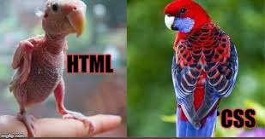
AGENDA
HTML
Semantic HTML
CSS
Intro to selectors
Specificity and order
Fonts and colors
CAPSTONE DEMOS

Slide 4
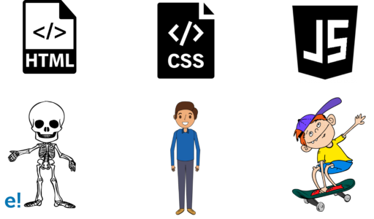
STRUCTURE
STYLE
BEHAVIOR

Slide 5




Example: Full Stack Application
Web services (for back end application data)
HTML/CSS/JS
GET/POST (images, html/css/js files)
HTML/CSS / JS
Application
Client
Server

Slide 6
HTML

Slide 7
HTML
HyperText Markup Language
HTML is the standard markup language for Web Pages.
HTML defines the structure of a web page.
HTML defines a document that will be displayed by a web browser.
HTML uses <> tags to represent elements that are the building blocks for a web page.
HyperText is text displayed by a device that has references (links) to other text that the reader can immediately access.
A Markup Language is a system for annotating a document in a way that syntactically distinguishes how to display the document and the content. When displayed Markup Language is not shown, instead it defines how to format the content.
HTTP or HyperText Transfer Protocol. HTTP is the primary protocol used to transfer HTML documents on the web.

Slide 8
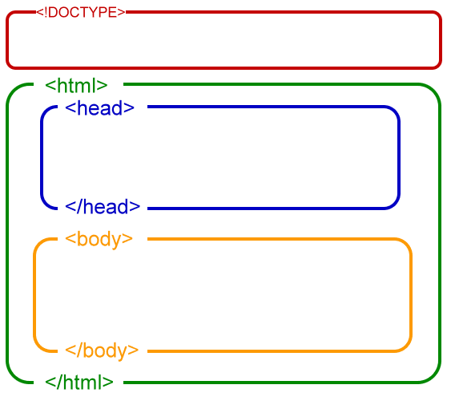
HTML DOCUMENTS
Notes:
Review the hierarchical nature of an HTML Document, including parents, descendants, and siblings.

Slide 9
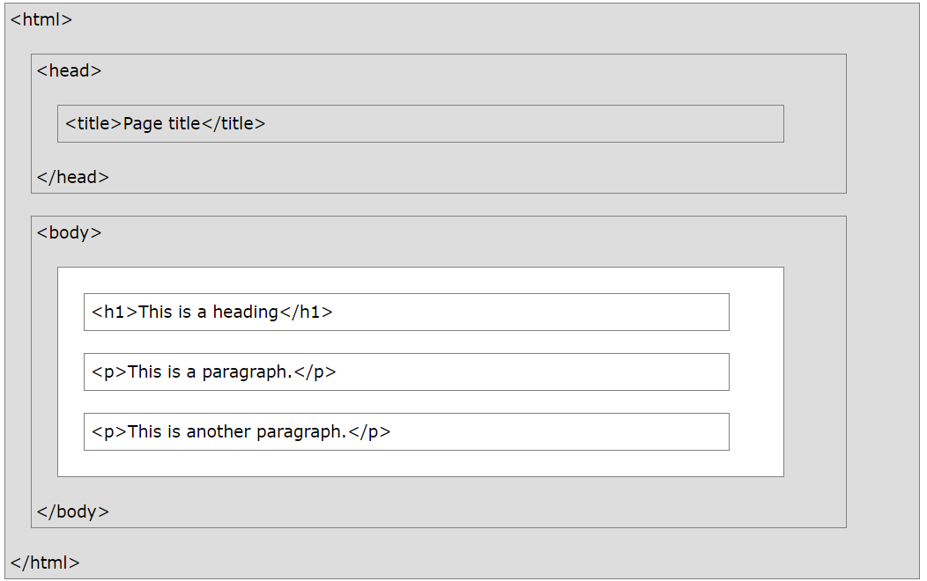
An HTML document must start with the Document Type Declaration.(not shown - <!DOCTYPE html> )
The HTML document begins with <html> and ends with </html>
The visible part of the document is between the <body> and </body>
Only the content inside the <body> section (the white area above) is displayed in a browser.

Slide 10
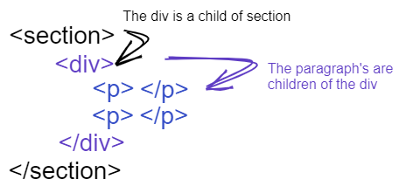
HTML Tag Hierarchies
HTML tags can have other HTML tags or content between their opening and closing tags. When a tag is placed in another tag it is said to be a child of the tag it is within. This creates a parent/child hierarchy.

Slide 11
COMMON TAGS
<p>This is a paragraph</p>
<div>This is a div.</div>
<span>This is a span</span>
<a href=”https://www.TechElevator.com”>Tech Elevator</a>
<input type=”email” id=”userEmail”> <!-- Note, no closing tag -->
<label for=”userEmail”>Enter your Name</label> <img src=”https://techelevator.com/images/logo.jpg”>
<form action=”https://someurl.com” method=”post”>
<!-- usually some other stuff like input, button, etc. -->
</form>

Slide 12
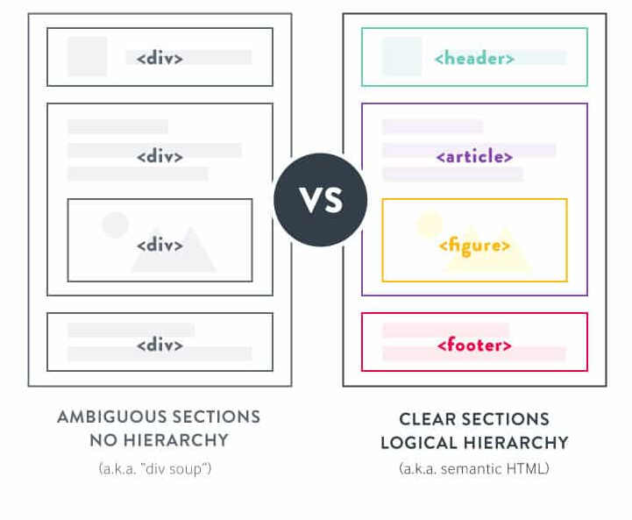
SEMANTIC HTML

Slide 13
WHY DOES THIS MATTER?
The Experience of Disabled Users / Screen Readers
Section 508 Compliance
Section 508 of the Rehabilitation Act of 1973(1998)(2018)
Search Engine Optimization and Performance
More readable HTML

Slide 14
SEMANTIC HTML TAGS
header
footer
main
aside
article
section
em
strong
form
a
img
p
input
table
nav

Slide 15
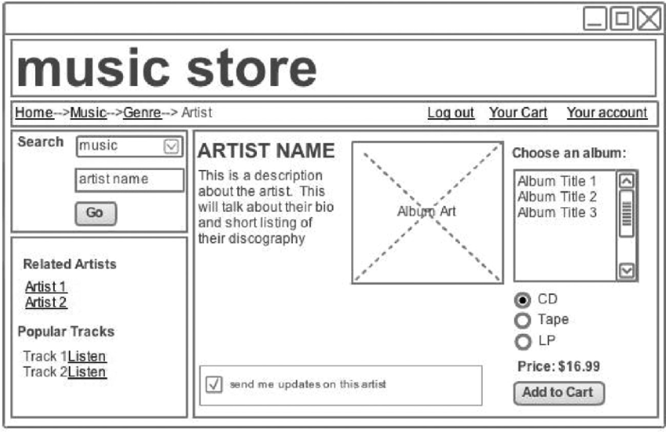
Can You Identify The Semantic HTML Components?

Slide 16
NON-SEMANTIC TAGS
div
span

Slide 17
HTML Forms
Forms are a way for the client to submit data to the server.
The form tag has 2 required elements:
action=”url”
method=”http_method”
<form action=”/api/reservations” method=”POST”>
If the action points to an endpoint URL on the same server where the HTML originated then it can be relative, otherwise it will be absolute.
<form action=”/api/reservations” method=”POST”> ← relative <form action=”http://localhost:8080/api/reservations” method=”POST”> ← absolute

Slide 18
HTML Form Elements
Form elements are HTML tags that allow users to input data to be sent in the request to the server. (https://www.w3schools.com/html/html_form_elements.asp)
Form tag elements:
type - sets the type of user interaction (radio button, text field, checkbox, etc)
id - name unique to the page that is used to internally identify the input field by CSS and JavaScript
name - key name to use in the query string, request body for the data
<input id="reservationName" name="reservationName" type="text" />
Common Interview Question: What is the difference between id and name on a HTML form element? Id is used internally by the page (JavaScript, CSS) Name sets the key to use for the data when submitted to the server.

Slide 19

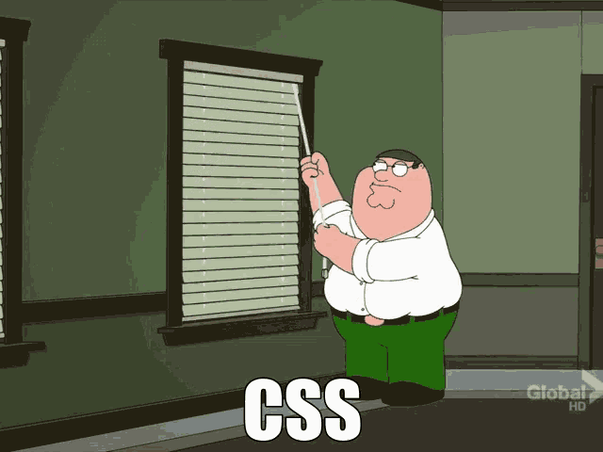
CSS

Slide 20
CSS
CSS (Cascading Style Sheet)
CSS defines presentation for an HTML document.
CSS Rule format:
selector { rule:value; }
img { height: 200px;
}
Adding a CSS file to an HTML file.
For a file named styles.css:
<link rel=”stylesheet” href=”styles.css” />

Slide 21
CSS LOCATION
inline on any element with a style attribute
Don’t do this
within the document under a <style> element
You can do this
through an external document reference with a <link href=> element
Almost always do this

Slide 22
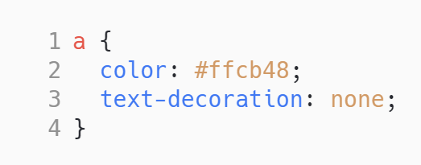
CSS STRUCTURE
(for <style> or file)

Slide 23
CSS STRUCTURE
Selector

Slide 24
CSS STRUCTURE
Rules

Slide 25
CSS STRUCTURE

Slide 26
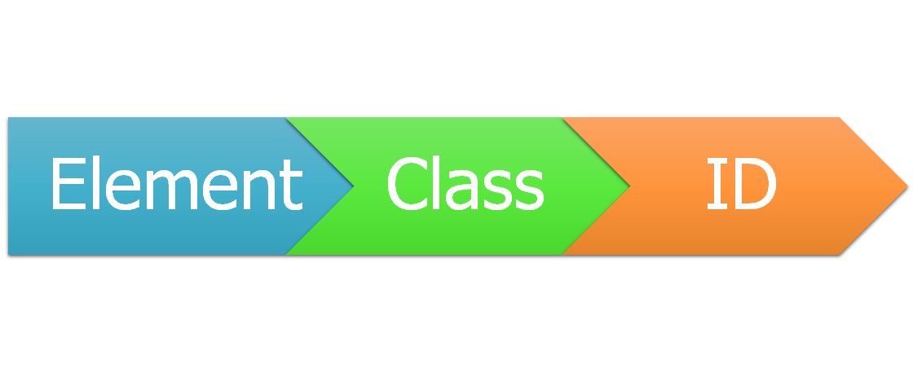
TYPES OF SELECTORS
 | In HTML
<a> | <a class=”red-text-anchor”> | <a id=”idname”>
 | In CSS
a | .red-text-anchor | #idname { }

Slide 27
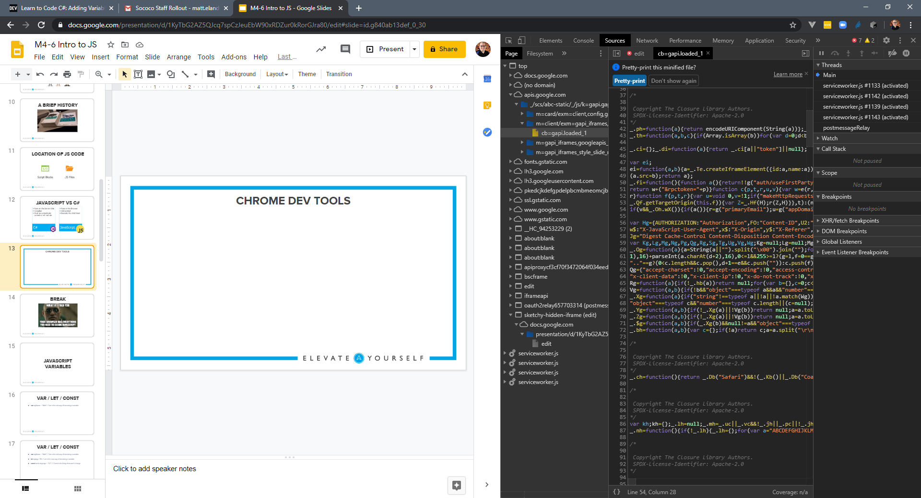
CHROME DEV TOOLS & CSS / HTML

Slide 28
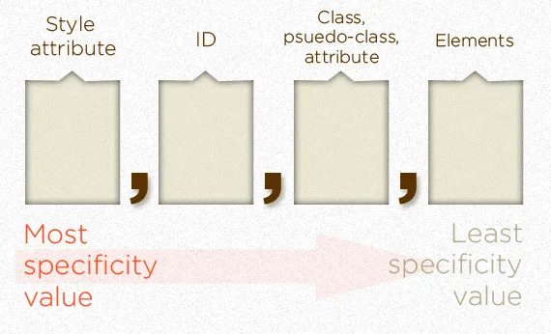
SPECIFICITY

Slide 29
Fonts are your friends
https://www.w3schools.com/css/css_font.asp
Browser provides a default font
Set the font in css for all or part of the page
Browser may not provide all fonts, so provide a fallback or two
Web-safe fonts

Slide 30
CHEAT SHEETS
https://htmlcheatsheet.com/
https://htmlcheatsheet.com/css/
https://www.w3schools.com/

